Slide 2
2016 EMC-S Chapter Chair activity presentation, Training Session and Dinner
IEEE EMC Society BeNeLux chapter
Notes:
previous engagement

Slide 3
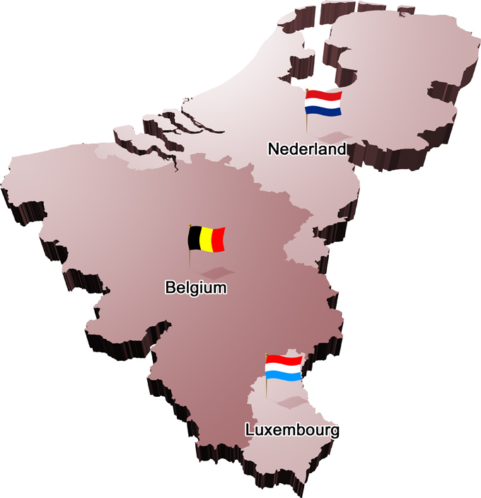
BeNeLux chapter
Chair: Frank Leferink
Secretary: Davy Pissoort
Treasurer: Cees Keyer

Slide 4
Activities
Most activities are organised in collaboration with the Dutch EMC-ESD society (Cees was chair until July 18th 2015, still a board member)
IEEE DL lectures are often organised in collaboration with the German chapter to reduce travel costs (/event)

Slide 5
Activities end 2015 - July 2016
27 November 2015: workshop ESD on ionisation, FHI Leusden
2-3 December 2015: PCB Design and Layout Techniques for Cost-Effective SI, PI and EMC, Ostend
27 april 2016, Seminar Modeling and Simulation of Electromagnetic Compatibility Problems, Ostend, with 2 distinguished lecturers
26 May: ESD Seminar on ATEX, FHI, Leusden
3 June: EMRP EMC project workshop, Delft
7 June: EMC on Tour, University of Twente
22 juni: Meeting and tour, Space Expo, Noordwijk

Slide 6
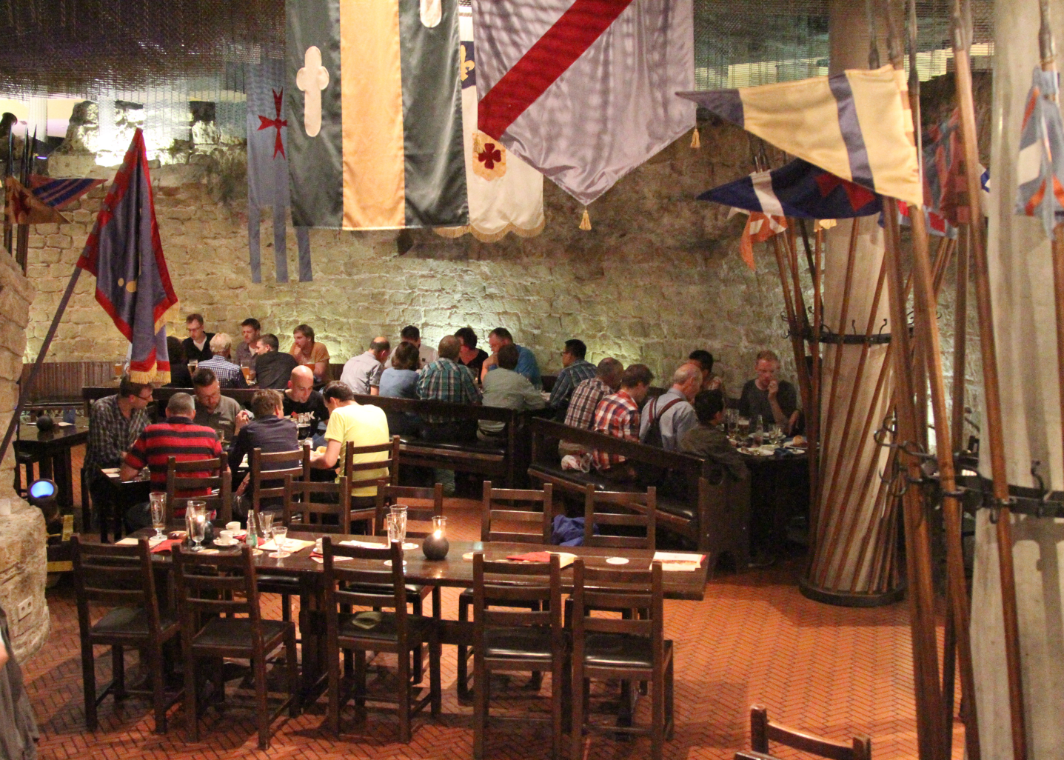
Old tradition started again: Social event during EMC Europe (here: Dresden 2015)

Slide 7
2018: EMC Europe, Amsterdam
2018 Joint IEEE International Symposium on EMC and APEMC, May 14-17, Singapore
2018 IEEE Symposium on EMC, SI & PI, 30 July – 3 August, Long Beach, California
27 – 30 August, EMC Europe 2018 in Amsterdam
in city center

